Slide 1
Training a Conv Net to Focus the Microscope

Slide 2
Problem
Current focus algorithm gets hung up on artifact, does not reliably choose a usable focus
Idea: train a convolutional neural network to detect good vs. bad focus and tell the microscope how many focus planes to move to correct it

Slide 3
Conv Net Overview
I could probably make an entire slide or several slides to dig into any of these bullets, is this a direction we would want to go in?
Based on organization of the visual system
Convolutional neural net is well suited for image classification
Network is given one set of data for training, then tested on a different set
Results of training and testing rounds are used to update the weights of the model

Slide 4
Making a Training Set
On one hand this is not the most groundbreaking thing, on the other hand people in the lab might see uses for this code in their own projects and I would like them to know it’s there for use and modification
Code to find image stacks in an experiment folder
Opens up a flipbook of the stack RisWidget
Button in RisWidget will create a text file in the stack with the number of the best focus image
Steps from 0 to 44
Also has an option for “no worm” so the stack will be excluded from training

Slide 5
Sort Images for PyTorch Import
PyTorch detects which class an image belongs to based on the folder it is stored in
Sorter code finds image stacks, detects if there is a best.txt file, then copies the image into a folder based on how far from the best focus the image is
3 category: above, good, below
5 category: very out of focus above, slightly out above, good, slightly out below, very out below
Could put example images here

Slide 6
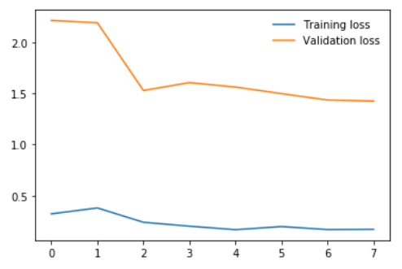
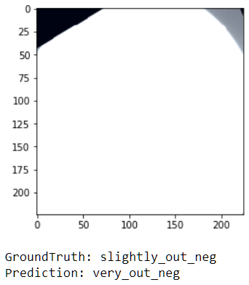
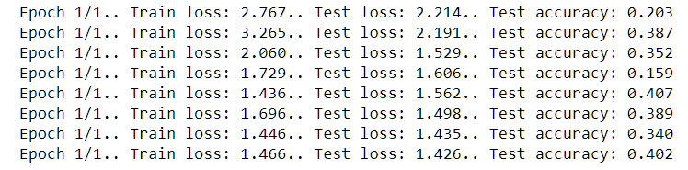
Initial Training
Trained Resnet50 using code mostly from tutorial
Training started to plateau around 40% accuracy
Took a look at the training images after import with Pytorch ImageFolder dataset

Slide 7
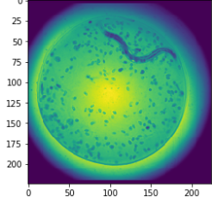
Import Images into Pytorch
Created custom code to do this – pre-made networks such as Resnet expect 224 by 224 (or smaller) RGB images
Shrink the image, then stack 3x
Substantial loss of resolution
Still much better than ImageFolder
Future direction: building a model from scratch that will take 1D black and white images so less information is lost in this step

Slide 8
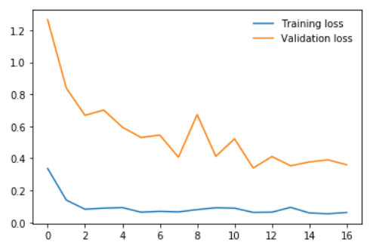
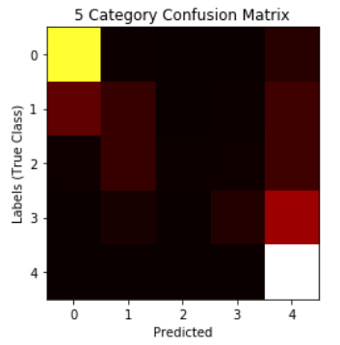
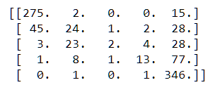
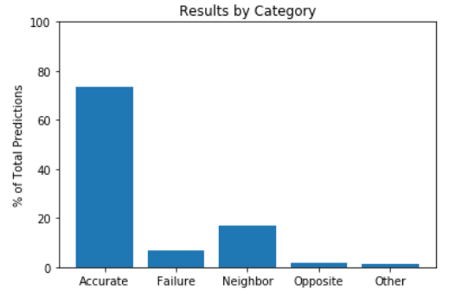
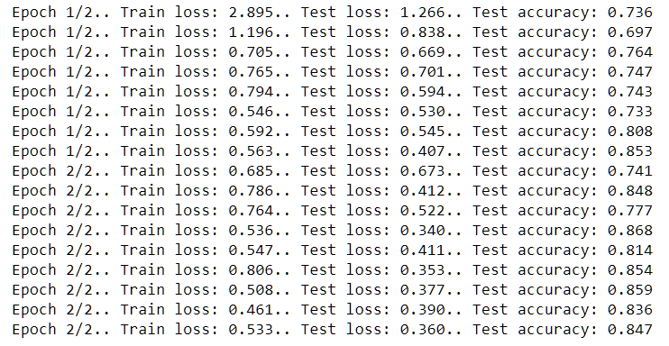
Training with Better Images – 5 Categories

Slide 9
Applying the Model – Funnel Algorithm
Funnel algorithm updates the upper and lower bounds on each prediction
Moves to a new focus plane ~2/3 of the distance from the current position to the opposite bound

Slide 10
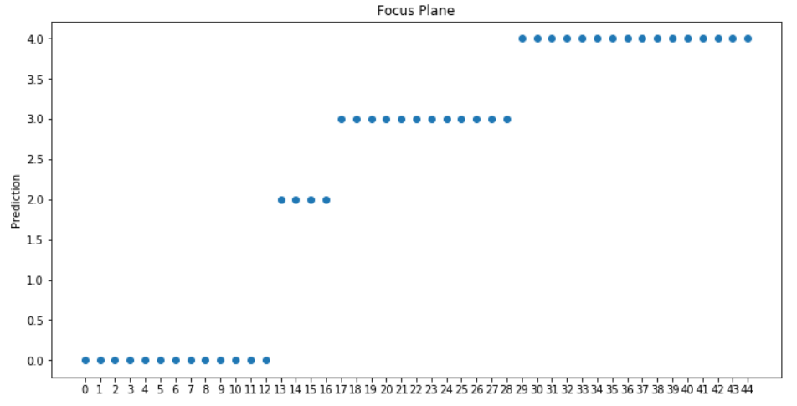
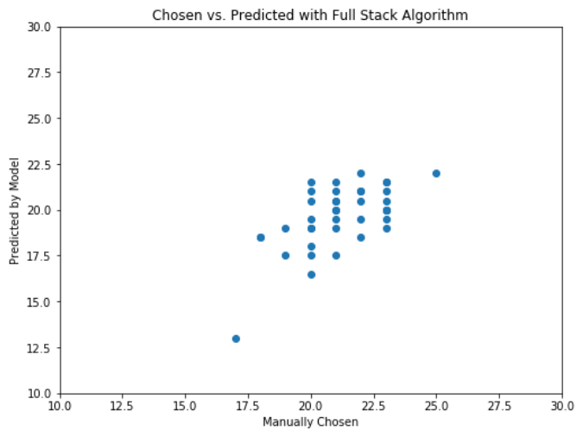
Applying the Model – Full Stack Algorithm
Go through each image in the stack, generate a prediction
Select the median of all images predicted to be in-focus as the best focus
Very out positive
Slightly out positive
In focus
Slightly out negative
Very out negative

Slide 11
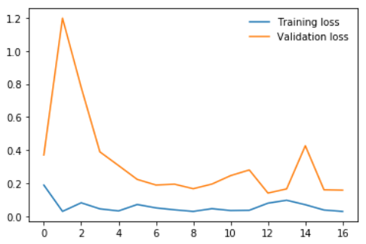

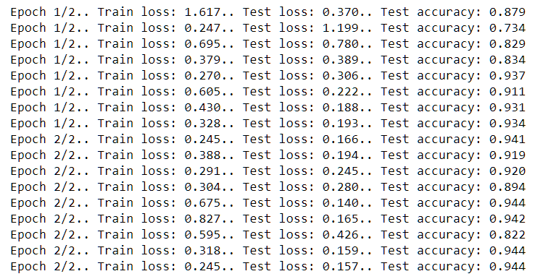
Training with 3 Categories
Confusion Matrix for 3 Cat
True
Predicted
Accuracy exceeded 90% by the 5th round of training
HOWEVER
In a stack of 44 images, only 3 are considered good focus. This network learned that it’s a poor bet to classify anything as good focus.
True
Predicted

Slide 12
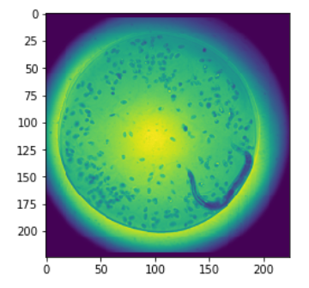
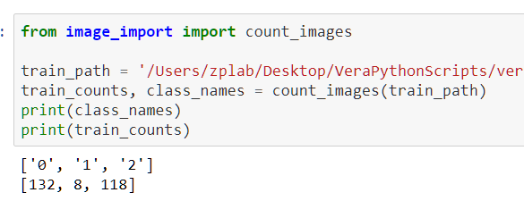
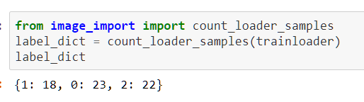
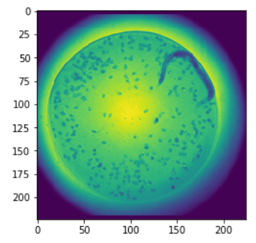
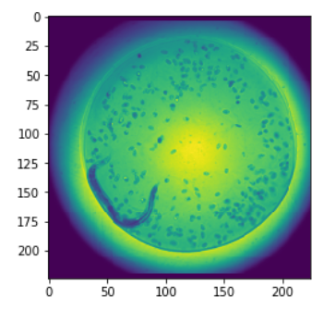
Correcting for Bias and Data Augmentation

Slide 13
Future Directions
Train with bias correction to get better identification of in-focus images
Build and train a model from scratch that will accept greyscale images

